Slide 1
T A L K I N G
C H U R C H

Slide 2
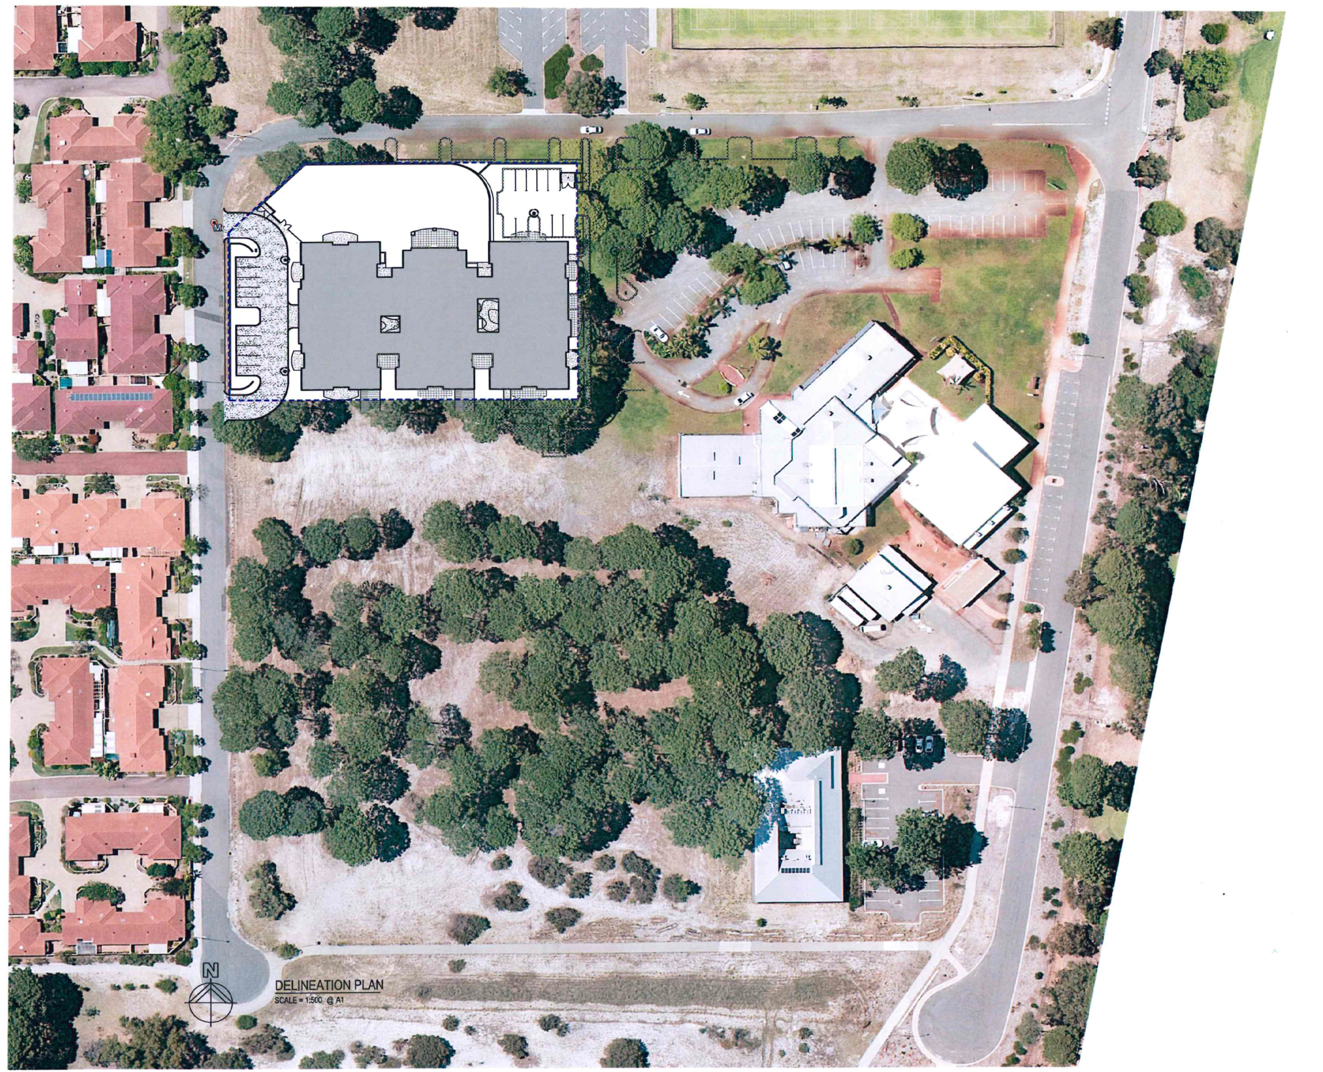

Slide 6
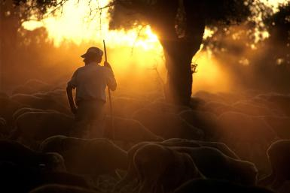
Psalm 23
A psalm of David.
1 The Lord is my shepherd, I lack nothing.
John 10:11 “I am the good shepherd. The good shepherd lays down his life for the sheep.”

Slide 7
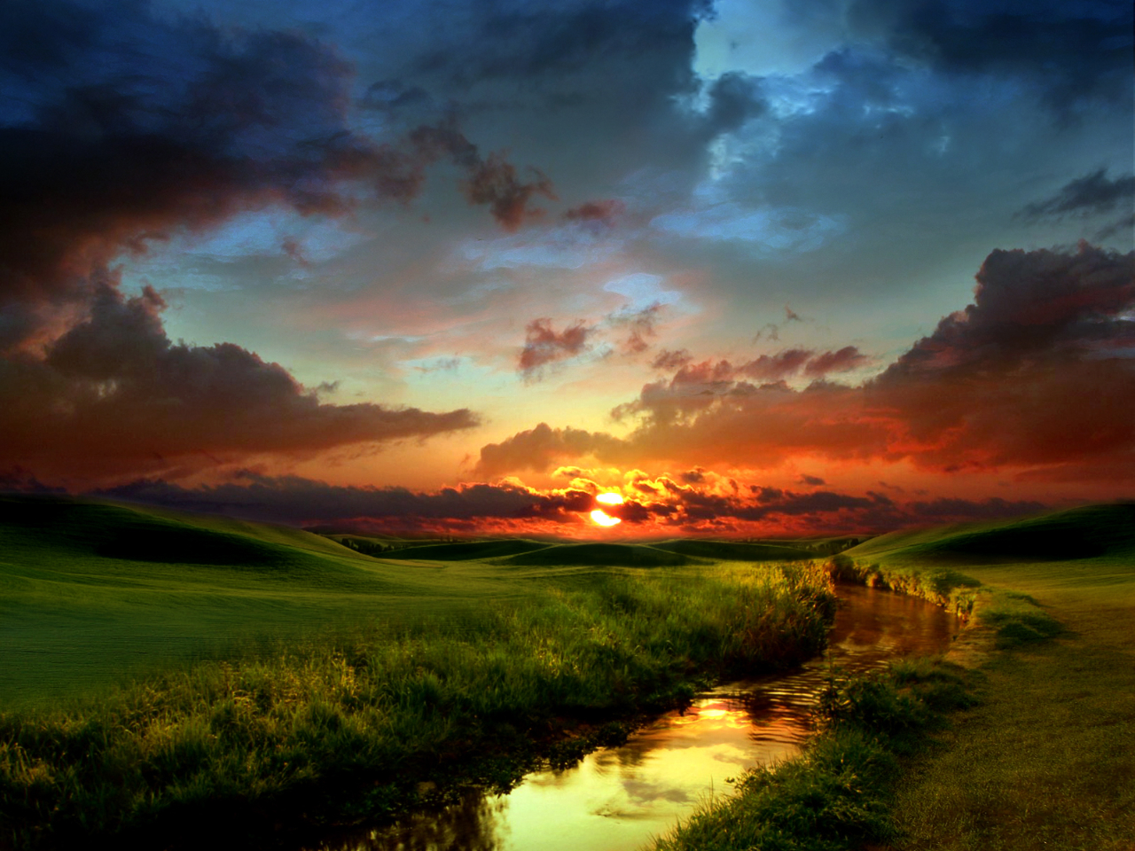
Psalm 23
2 He makes me lie down in green pastures,
he leads me beside quiet waters,
3 he refreshes my soul.

Slide 8
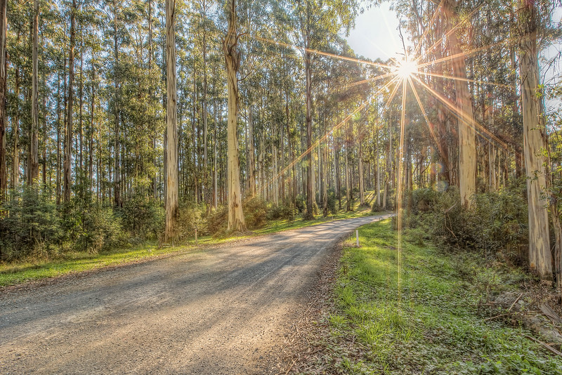
Psalm 23
3b He guides me along the right paths
for his name’s sake.

Slide 9
Psalm 23
4 Even though I walk
through the darkest valley,[a]
I will fear no evil,
for you are with me;
your rod and your staff,
they comfort me.

Slide 10
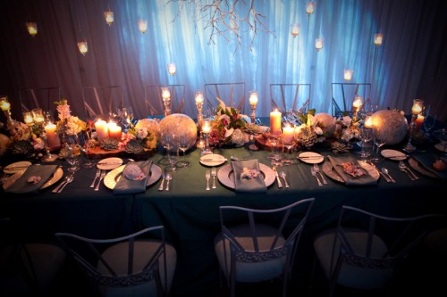
Psalm 23
5 You prepare a table before me
in the presence of my enemies.
You anoint my head with oil;
my cup overflows.
6 Surely your goodness and love will follow me
all the days of my life,
and I will dwell in the house of the Lord forever.

Slide 11
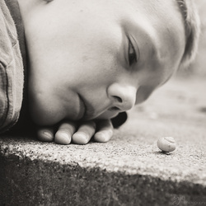
SO WHAT?
“What is the greatest challenge or concern that you are currently facing?”

